Slide 1
ANNUAL GENERAL MEETING

Slide 2
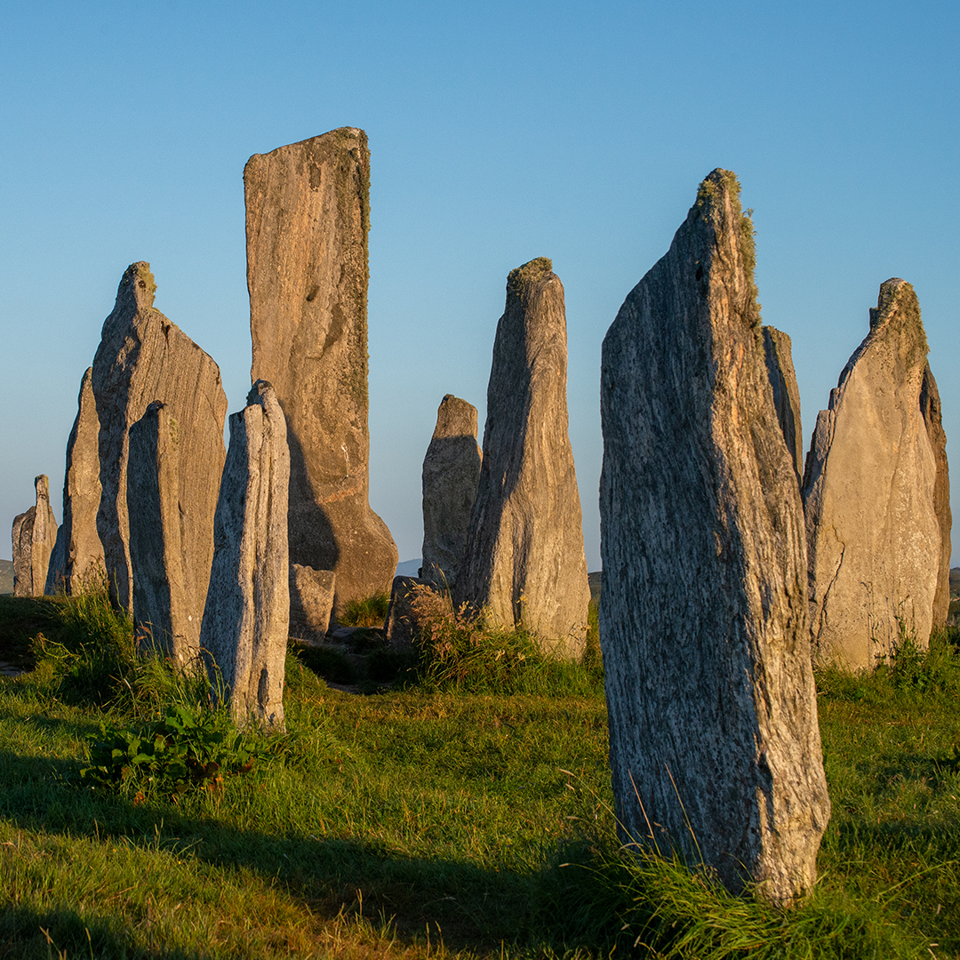
Welcome everyone
Thank you for coming!
Housekeeping

Slide 3
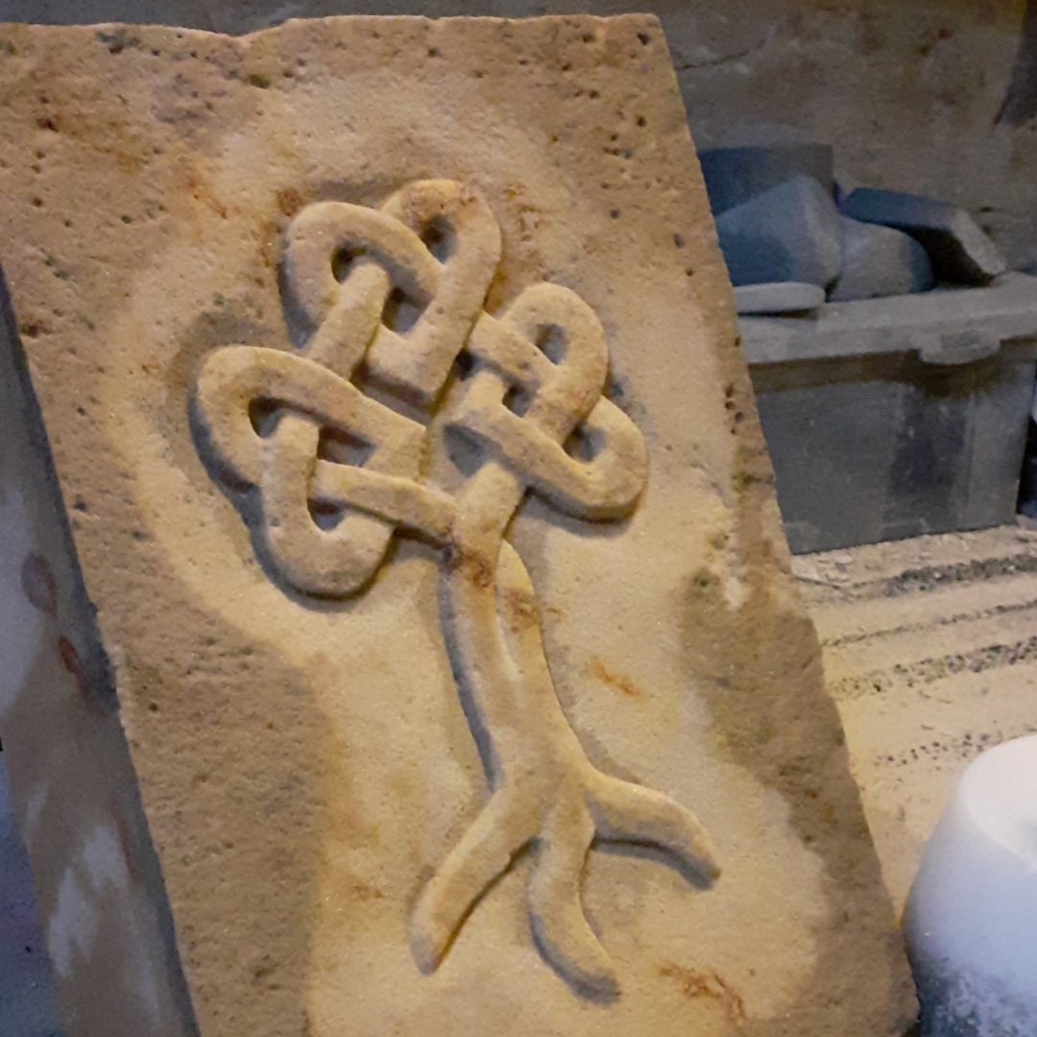
NEOS 2022 Context
- New Chair and new Committee
Volatile economy
Uncertain global situation
Death of Queen Elizabeth II
288 members
64 new members

Slide 4
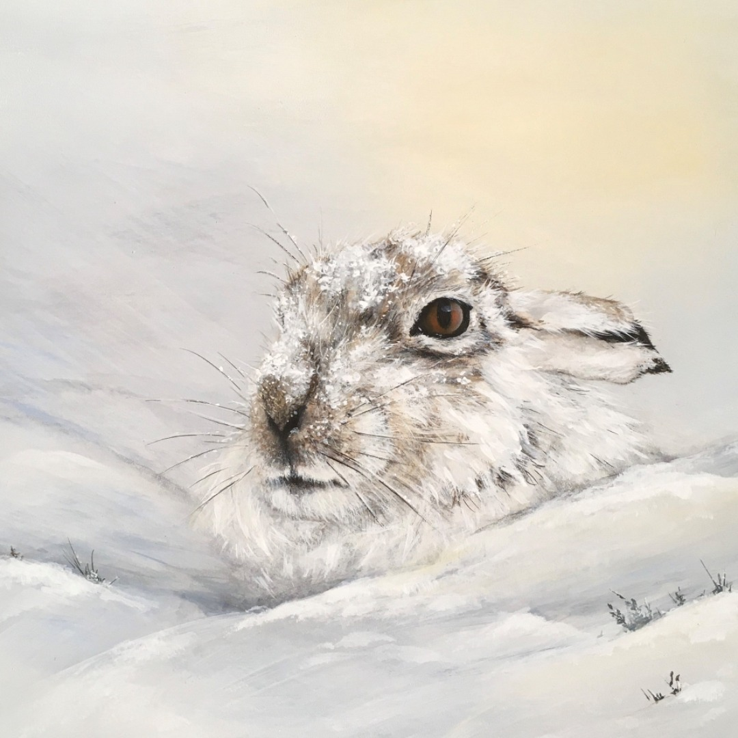
Members survey – May 2022
112 members responded
-sales, exposure and visibility
-meeting other artists and networking.
-social media posts to attract
-training in social media.
Follow Up Survey October 2022

Slide 6
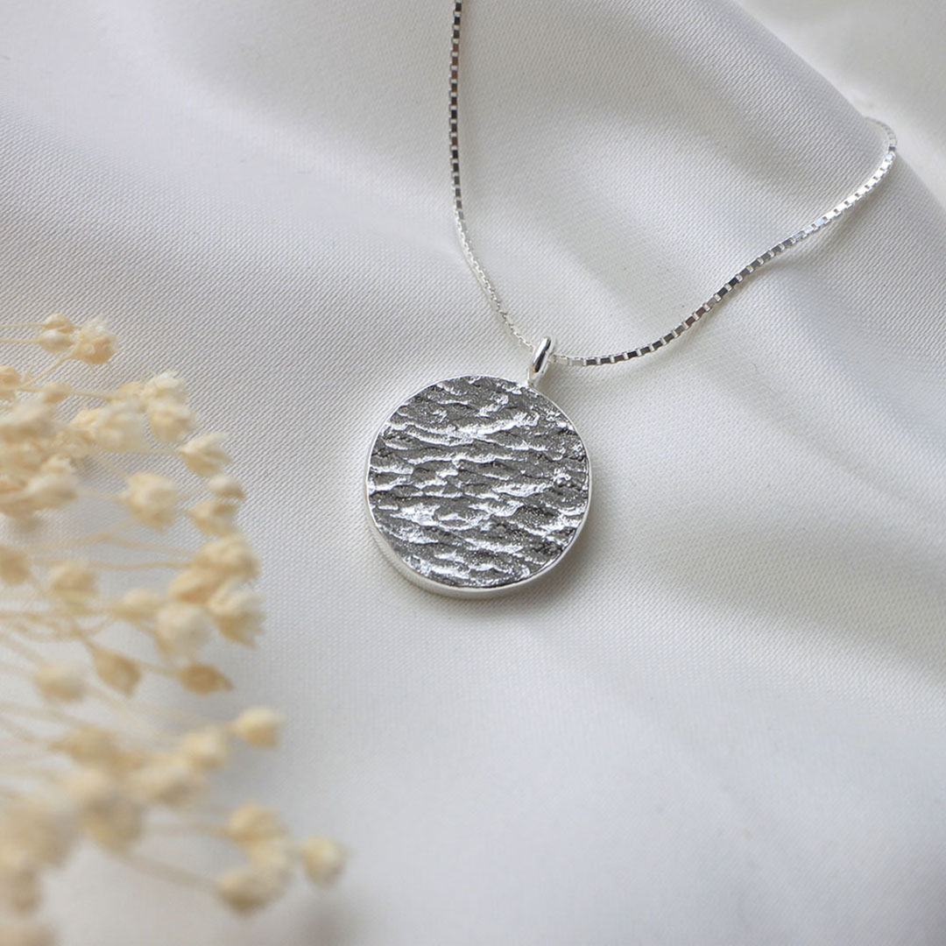
The Book
– 20,000 printed
Library service, visitor centres, shops, Art Aboyne, members
PUP’s
1 box of 50 per member/ 3 boxes per group
Distribution and print challenges

Slide 7
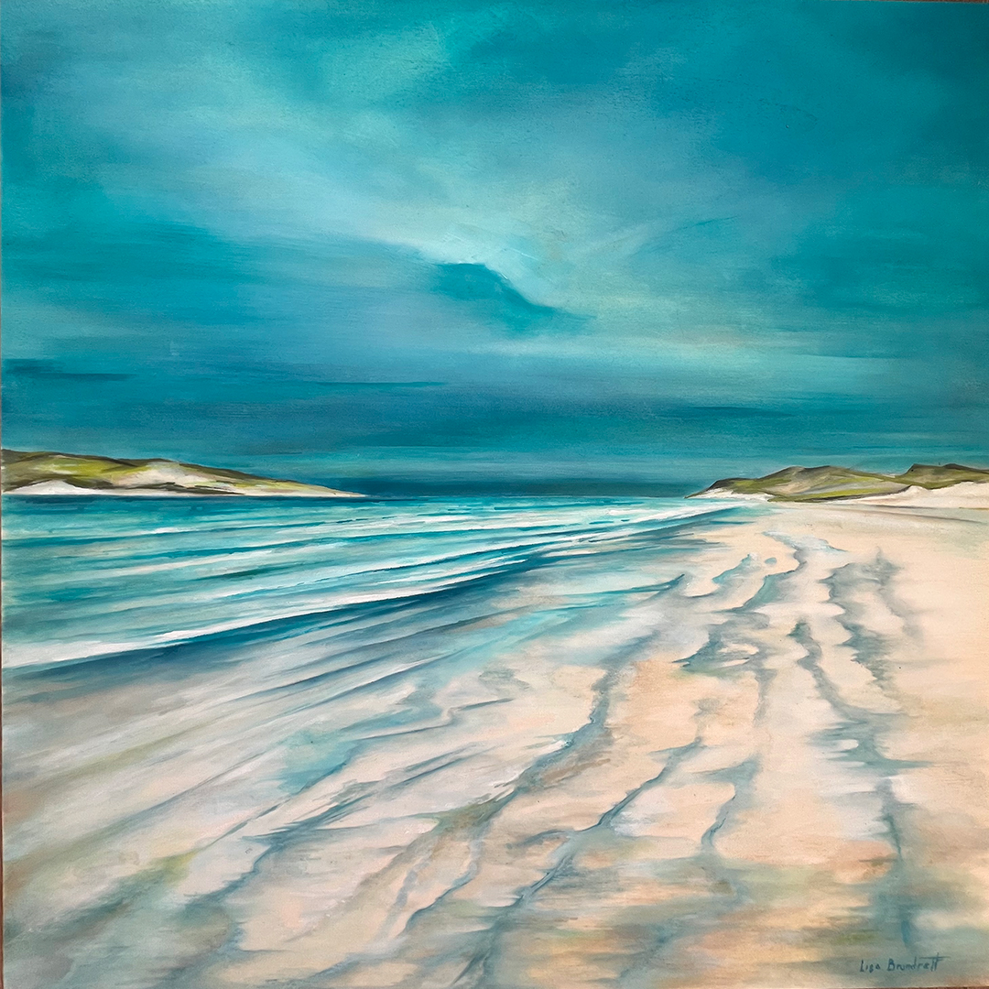
Social Media
- New contract to pay a Social
Media Co-ordinator (Louise)
- individual posts
- discipline videos
Social Media Teams: Facebook (Mahri, Suz, Carol); Instagram (Mahri, Anne, Catriona);
Internal Facebook page (Lynne)
Social media training through Business Gateway

Slide 8
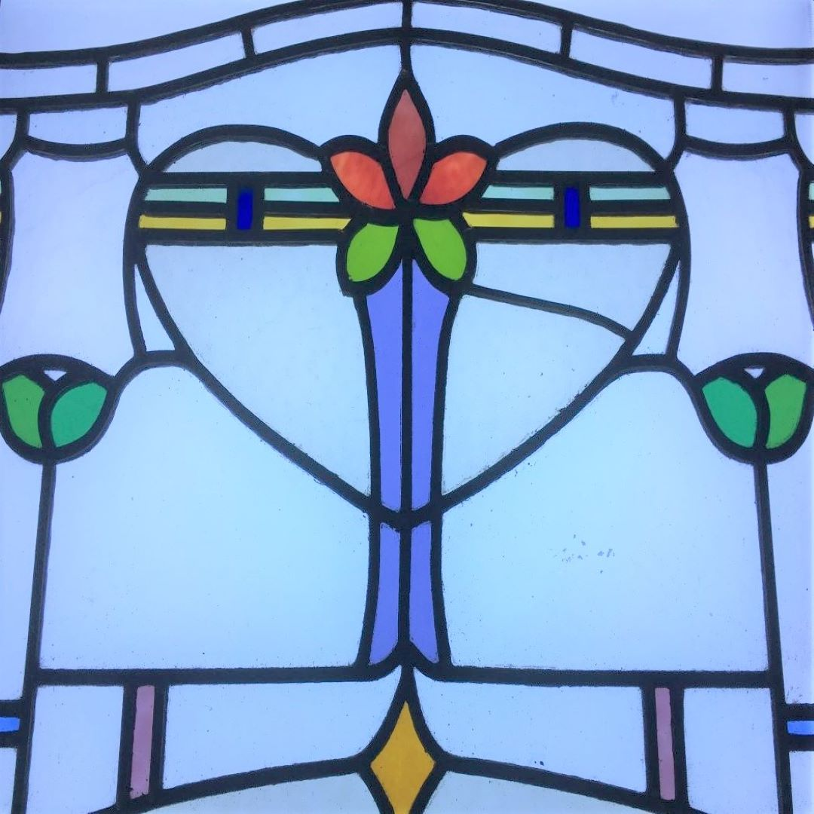
Advertising
- Artmag
Pushing Out The Boat mag
Press and Journal
Original 106 and Waves Radio
£50 prize in Lifestyle mag
Press releases to all local and regional press.
Turriff show

Slide 9
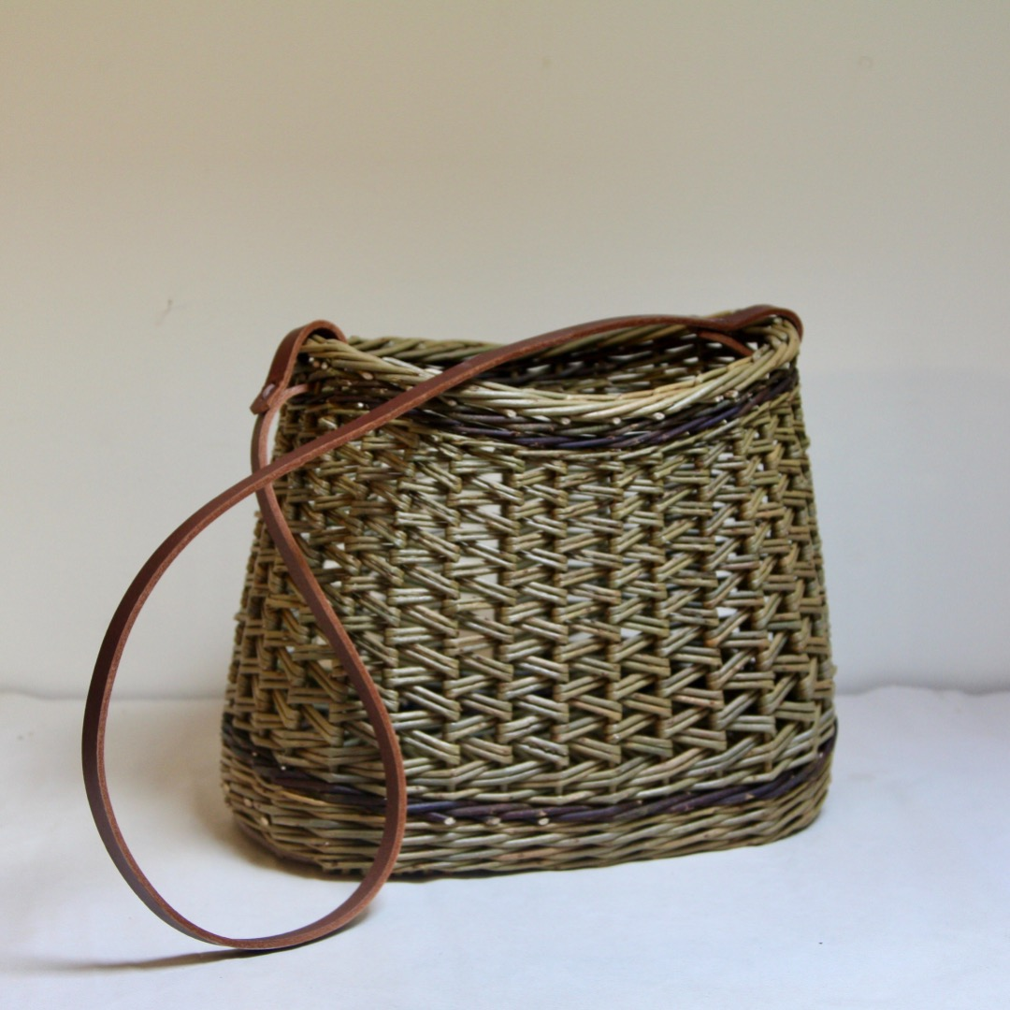
Website Insights
 | Jan-Oct 2022
 | 123,894 site visits
 | 1,872,544 hits (downloads)
 | Peak September but steady thru year
 | 44,638 unique visits
 | Sept 2022
 | 16,032 visits
 | First weekend peak
Thank you to Connie and Anne for the online location guide

Slide 10
Member Communications
Crak n’Blether – online, Elgin, Inverurie, Aberdeen
Emails and newsletters – mailchimps
Internal Facebook
New graphics and support

Slide 11
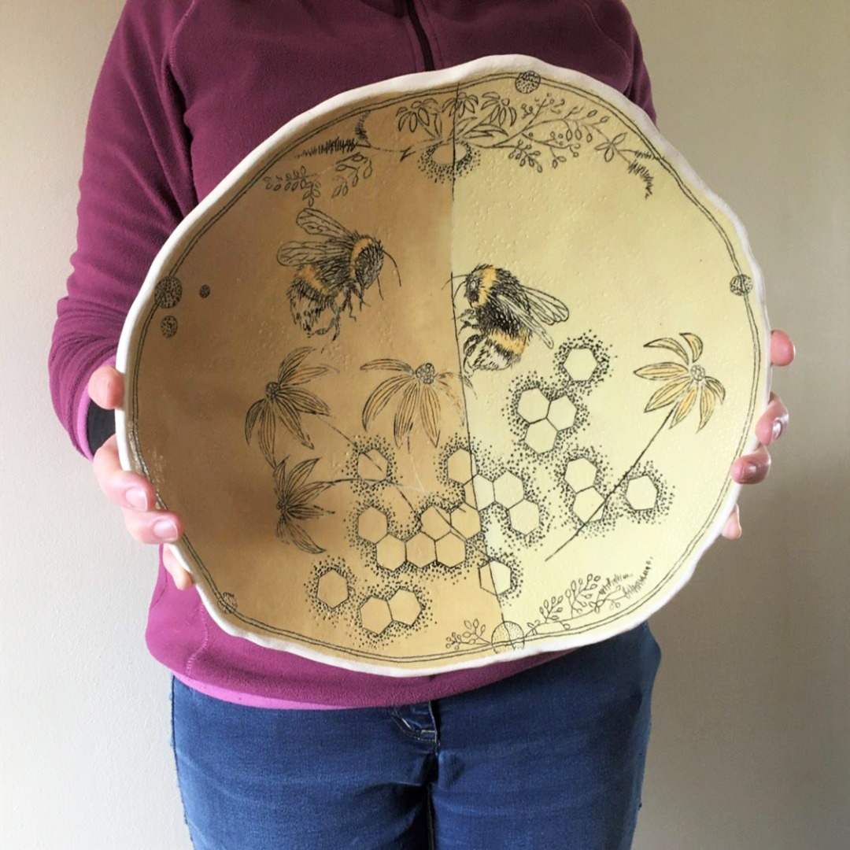
Thanks to the Committee of NEOS 2022
Chair – Lynne
Vice Chair – Charley
Secretary – Val
Treasurer – Amy
Co-ordinator- Louise
Social Media- Louise
Brian, Mahri, Carol, Connie, Catriona, Anne, Liz, Gerrie, Suz, Alison and Margaret
Phil Thompson & Matt Robinson
YOU HAVE BEEN AMAZING!

Slide 12
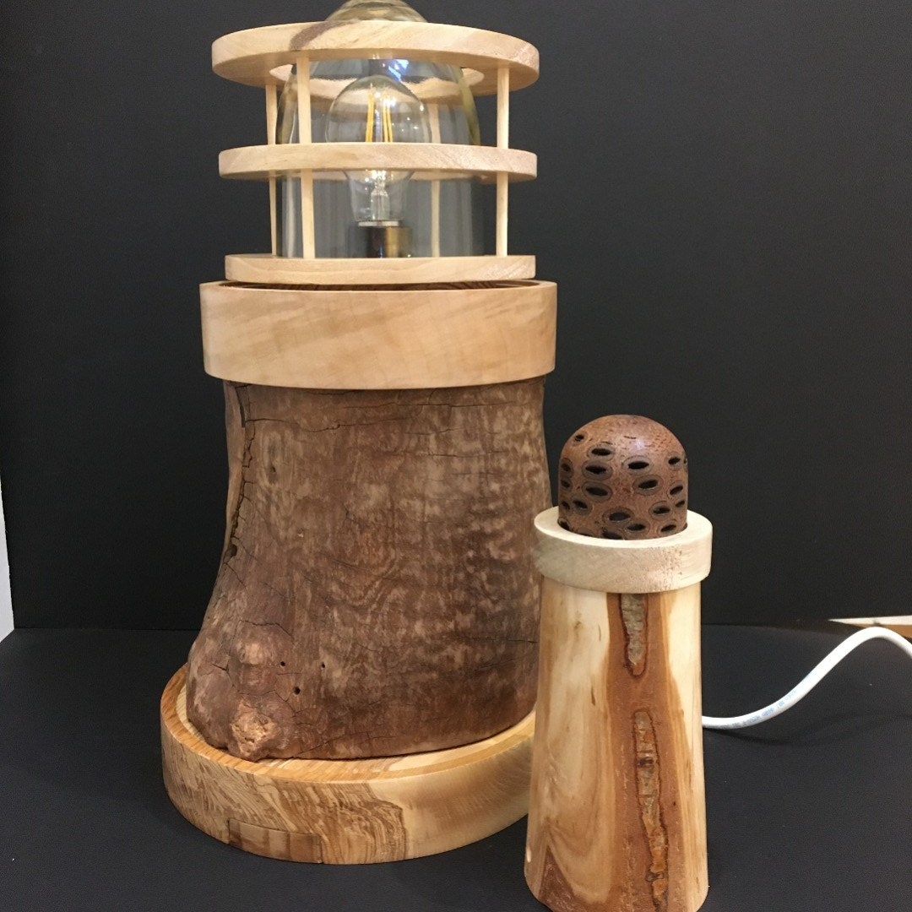
Treasurer’s Report
Amy Shennan Pates

Slide 13
 | Summary
 | Account |  | Income | Expenditure
 | Vendors |  | 43650
 | Website |  |  | 1258.38
 | Committee + Other |  | 150.75 | 1693.75
 | Mailchimp |  |  | 362.64
 | Marketing |  |  | 6759
 | Book + Graphics |  |  | 31483
 | Co-ordinator |  |  | 3750
 |  | Totals | 43800.75 | 45306.77
 |  | balance |  | -1506.02
Financial Report
Total in bank 30-09-22
£13,137.32

Slide 14
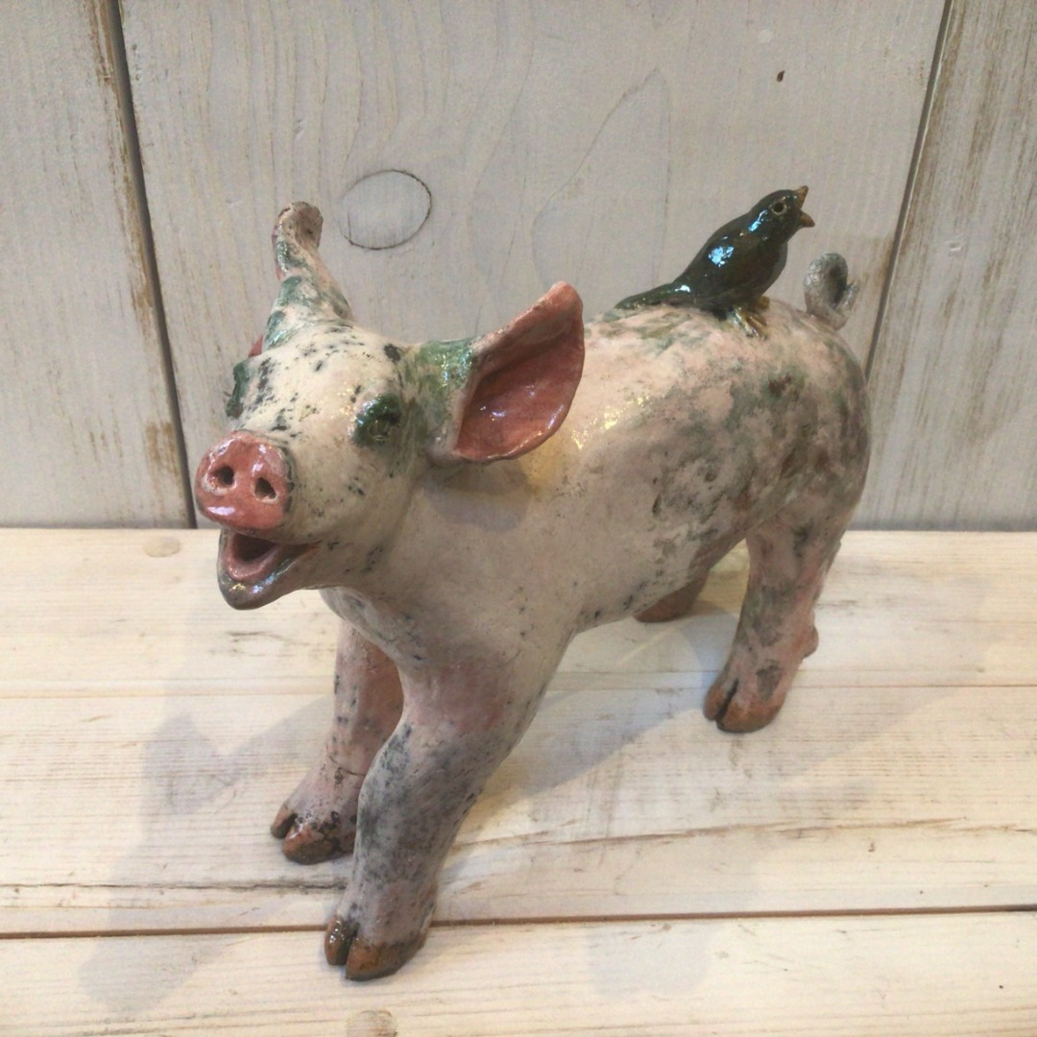
Co-ordinator’s Report
Louise Lemmon

Slide 15
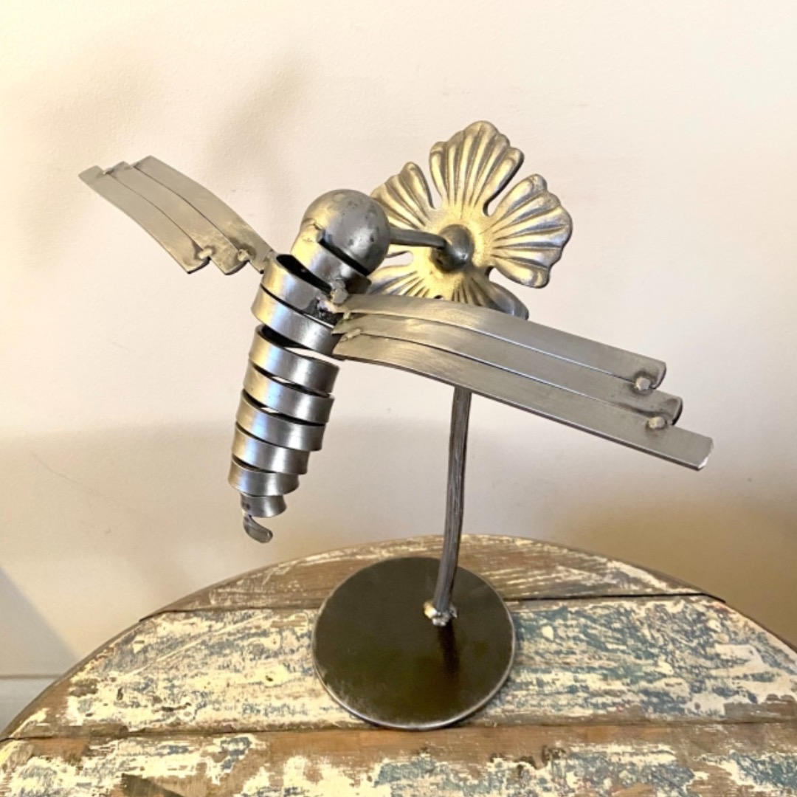
What do I do?
Assist members during sign up
Maintain and organise members database
Proofread (with other committee members) members’ entries for the book and website
Coordinate between the book designer and online location guide team
Edit members entries on the website
Organise Pick Up Points and Book Distribution

Slide 16
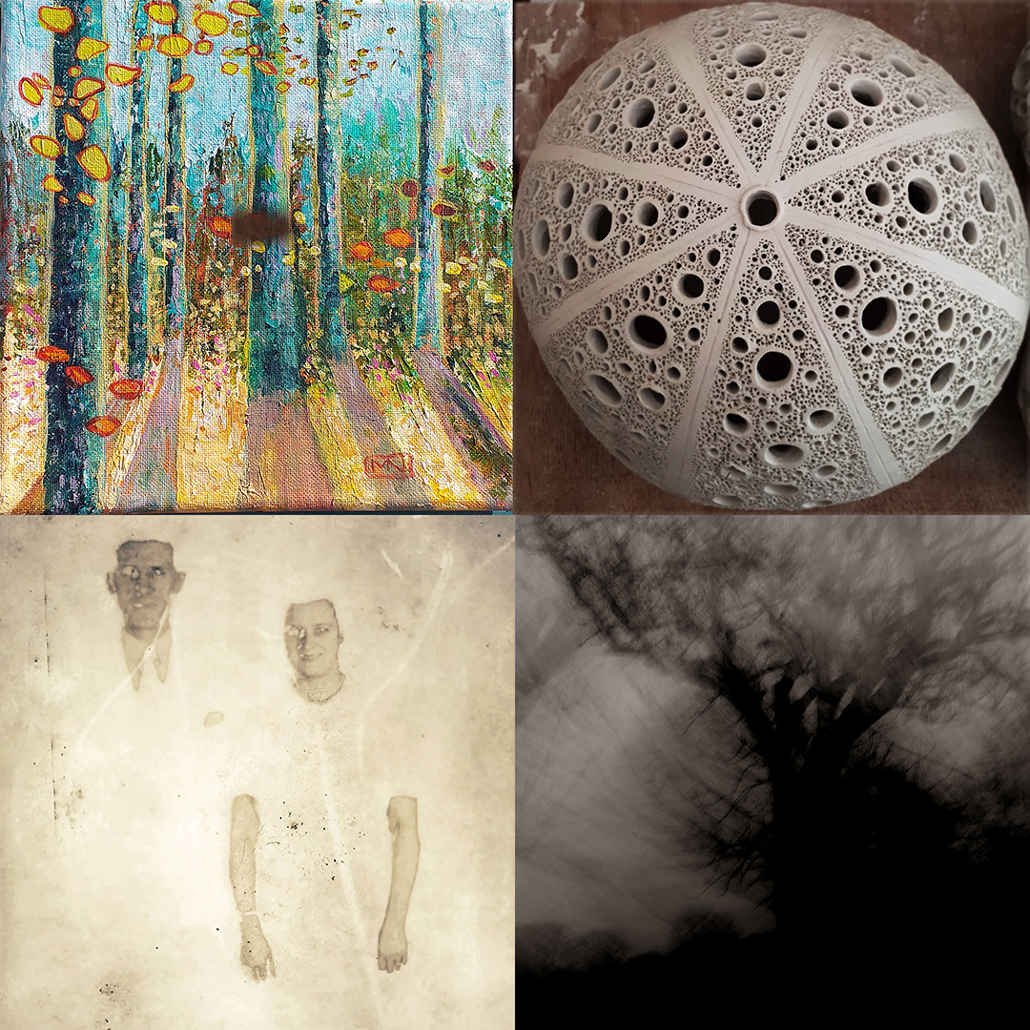
Summary of NEOS 2022:
Membership
Database Organisation
Late/Incomplete Entries
Out of Area Applications
Group Applications
Pick Up Points
Overview

Slide 17
Social Media
Coordinator Report
Louise Lemmon

Slide 18
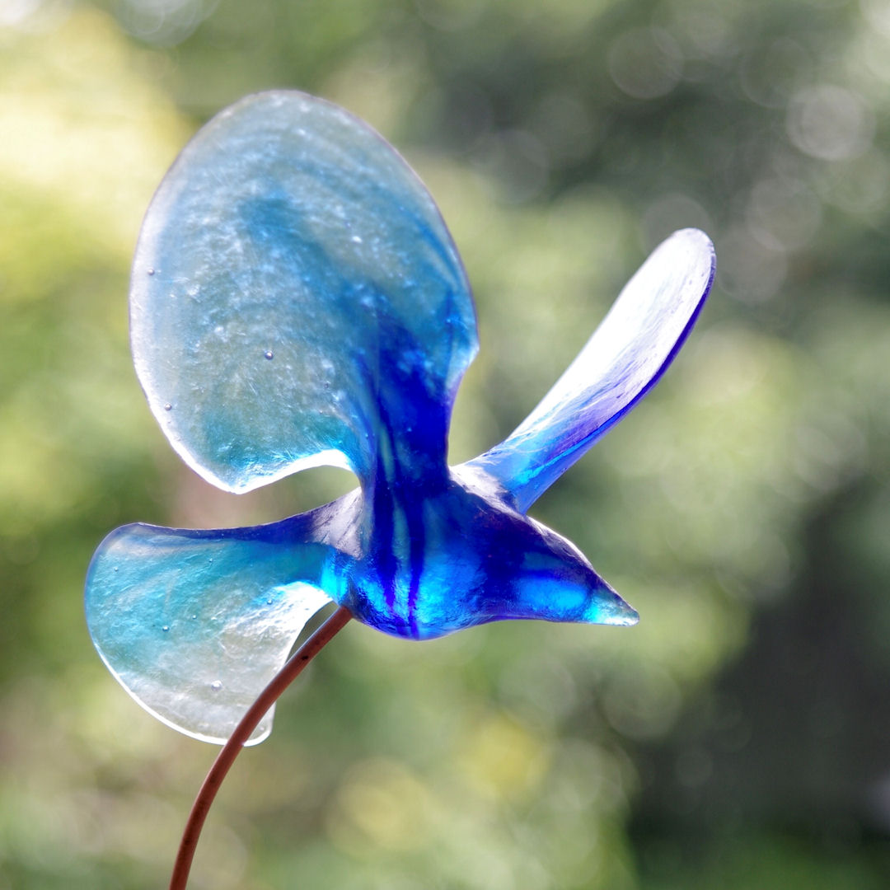
Social Media Coordinator – What do I do?
Agree the social media schedule from March (sign up) to September
Creation of a post for each member (approx. 300)
Production and posting of discipline videos and reel (approx. 30)
Analysis of social media outlets and report twice yearly (Sept 2022 and March 2023)
Co-ordinate with social media response teams as needed.

Slide 19
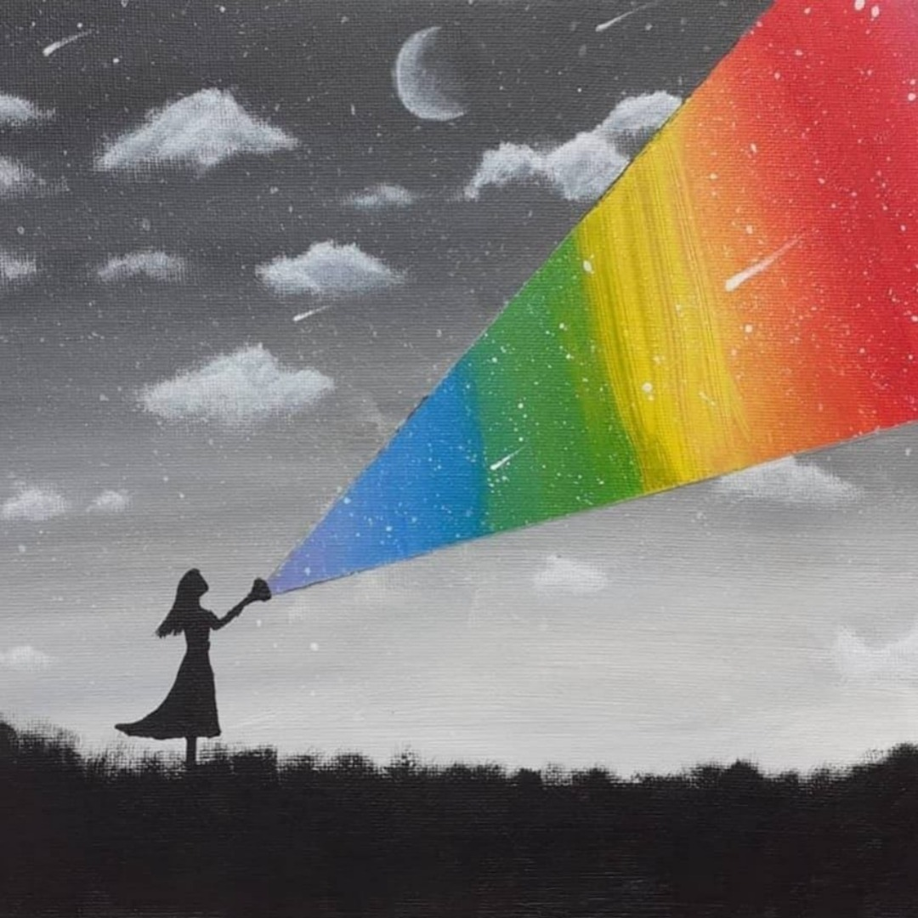
Social Media Summary
NEOS 2022:
Scheduling
Individual Member’s [social media] posts
Discipline Videos
NEOS 2022 Social Media Insights
Overview

Slide 20
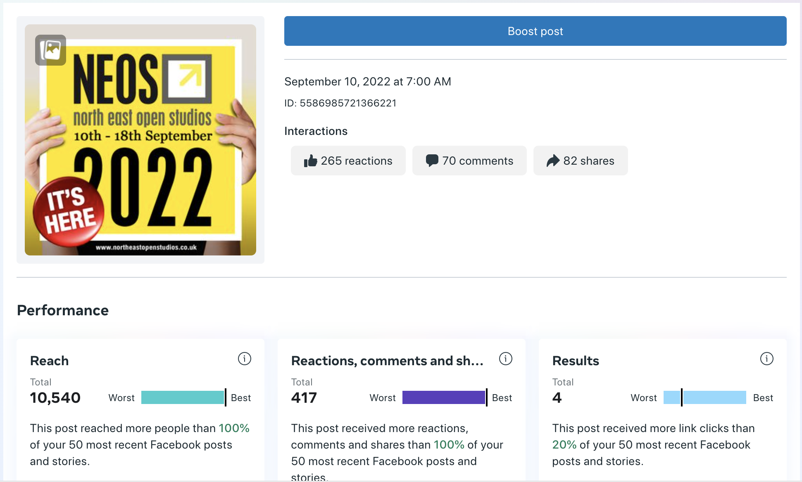

Slide 21
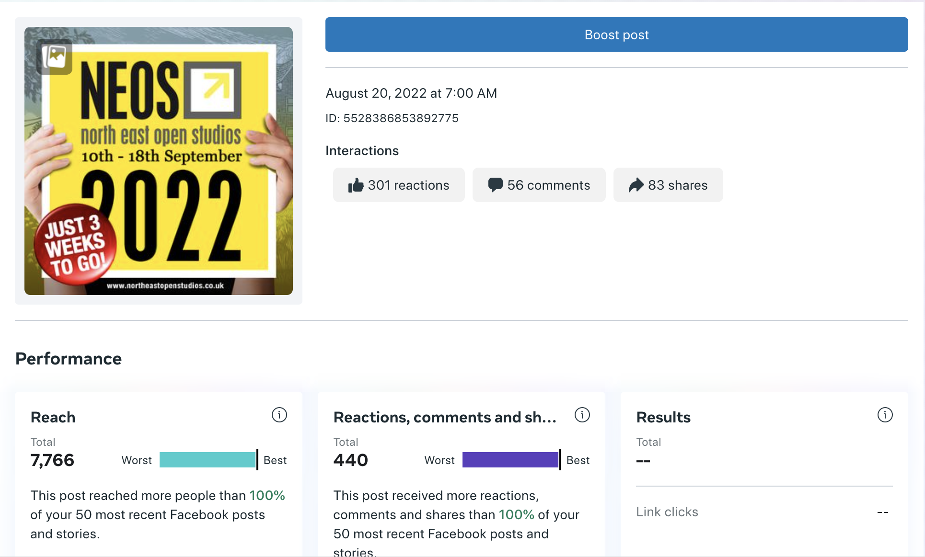

Slide 22
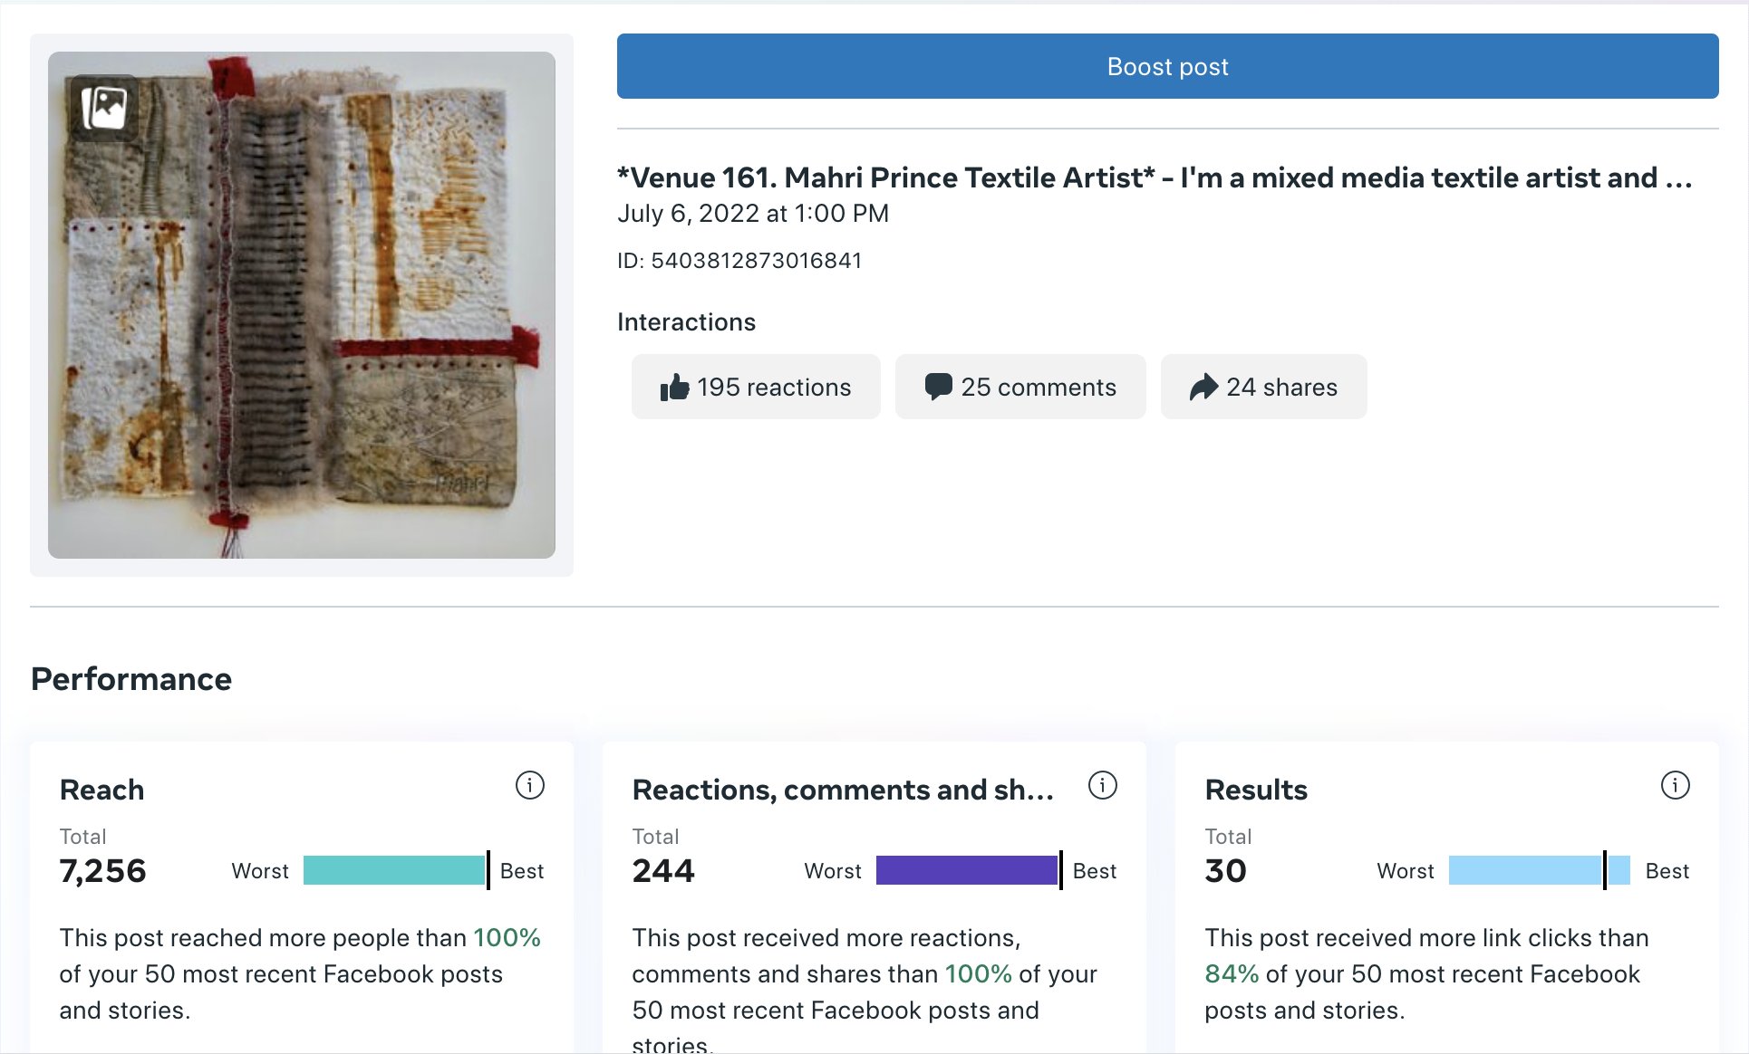

Slide 23
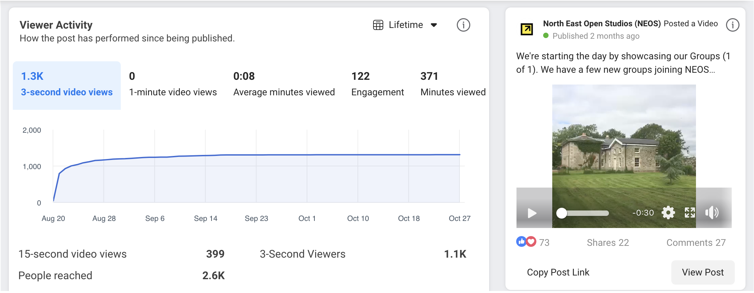

Slide 24
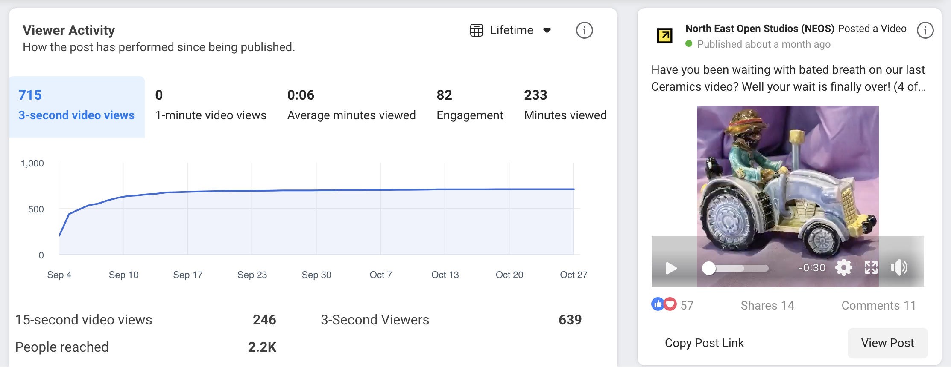

Slide 25
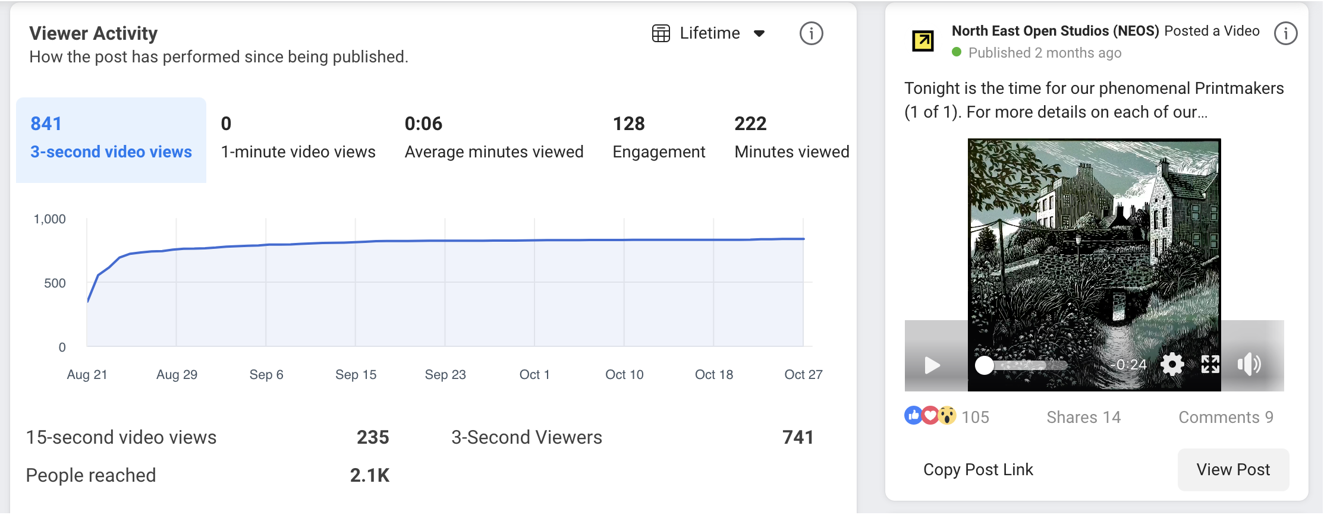

Slide 26
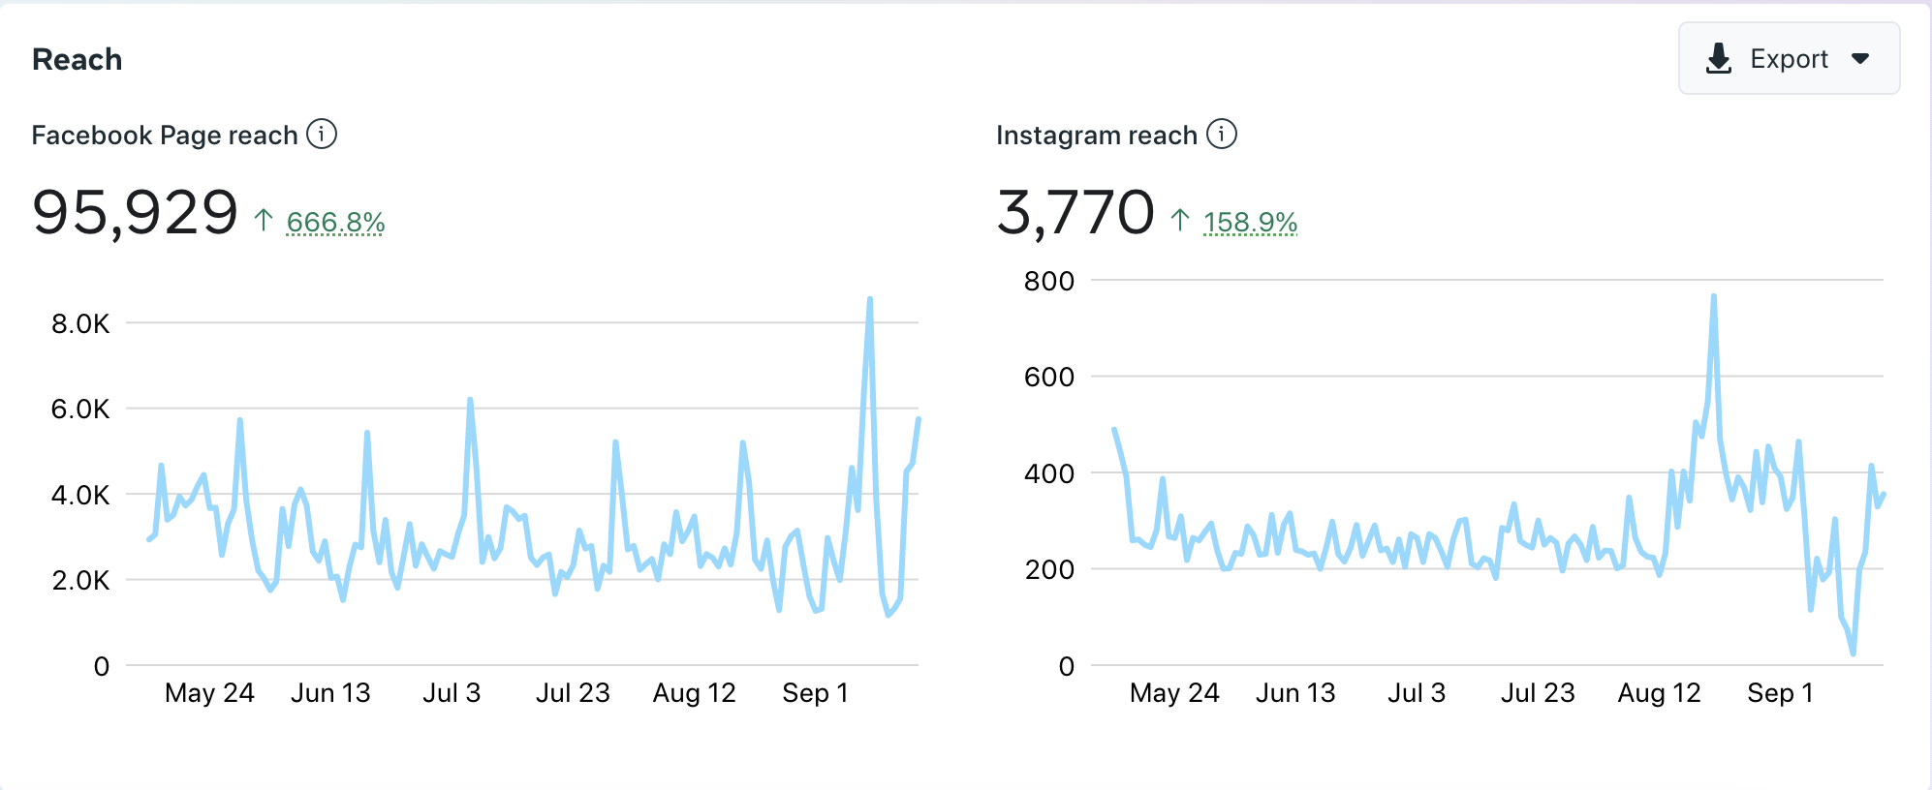
Overall Insights – Reach

Slide 27
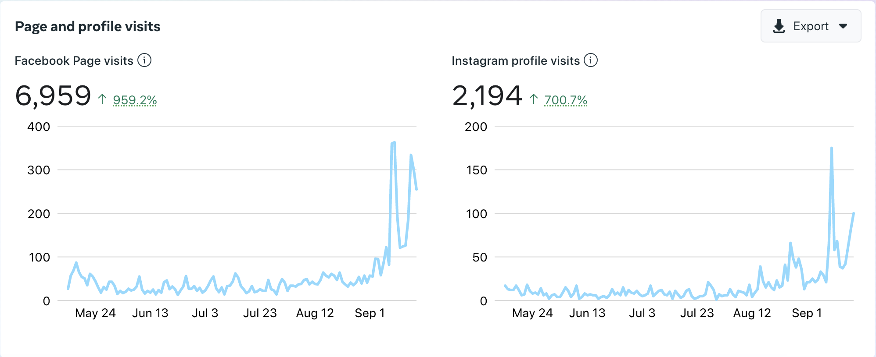
Overall Insights – Visits

Slide 28
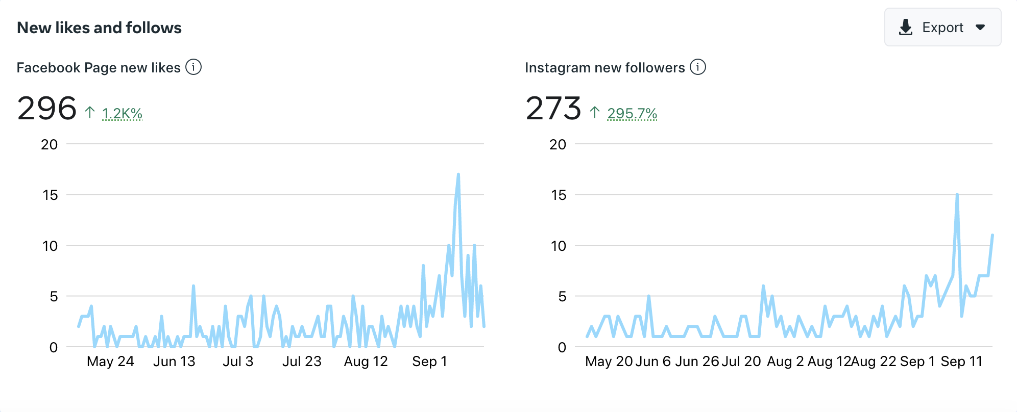
Overall Insights – Likes

Slide 29
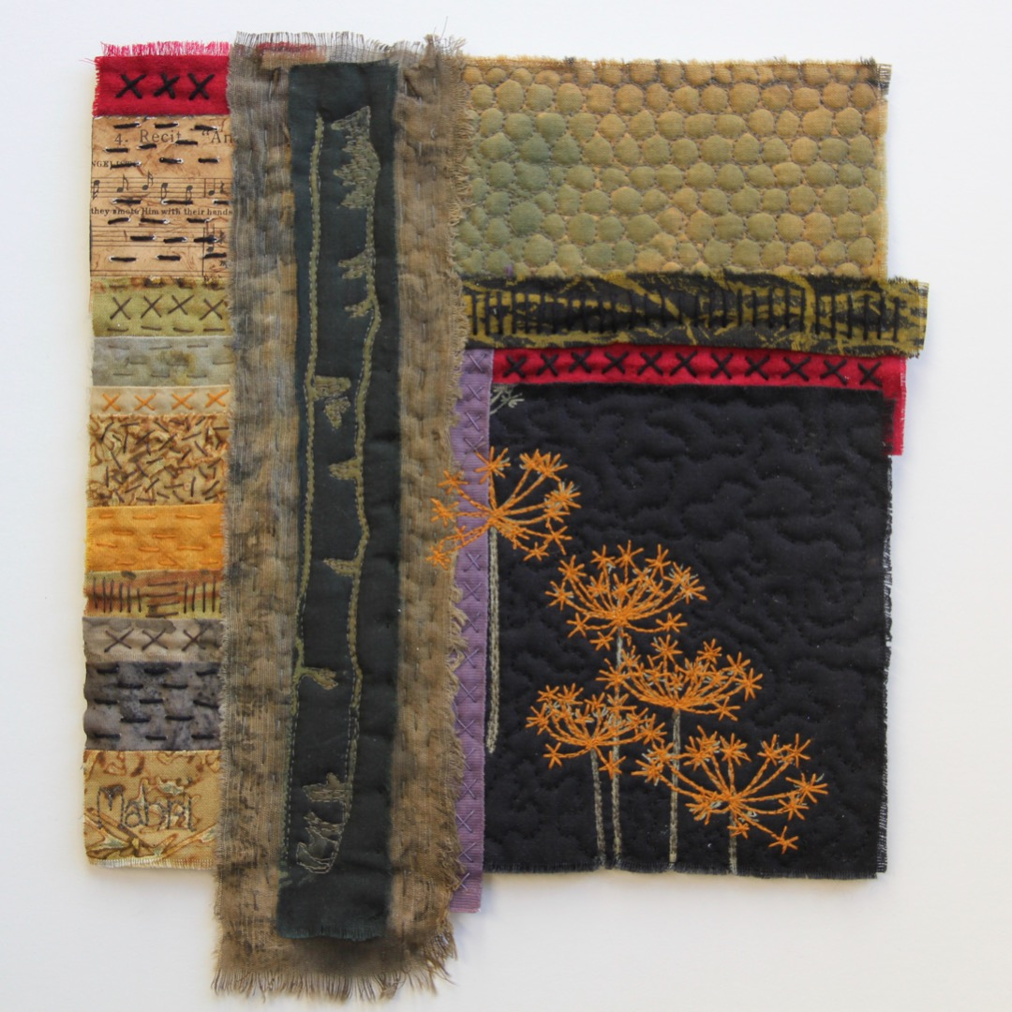
Initial Member Survey Results
70 responses -most have done NEOS 3x or more
Visitor no’s ranged from 25 to 700
Happy with comms and support
Majority met the expectations outlined in May 2022 survey
Priorities for next year – website, mobile phone app, increasing social media reach
73% okay with fee increase of £10-20

Slide 30
Initial Visitor Survey Results
217 responses of which 130 were returning visitors
Mainly from the Grampian area
Age group 55+
Main reasons for visiting were
To meet the makers
Buy direct from the makers
Browse products
Improvements – signage, book layout, local maps

Slide 31
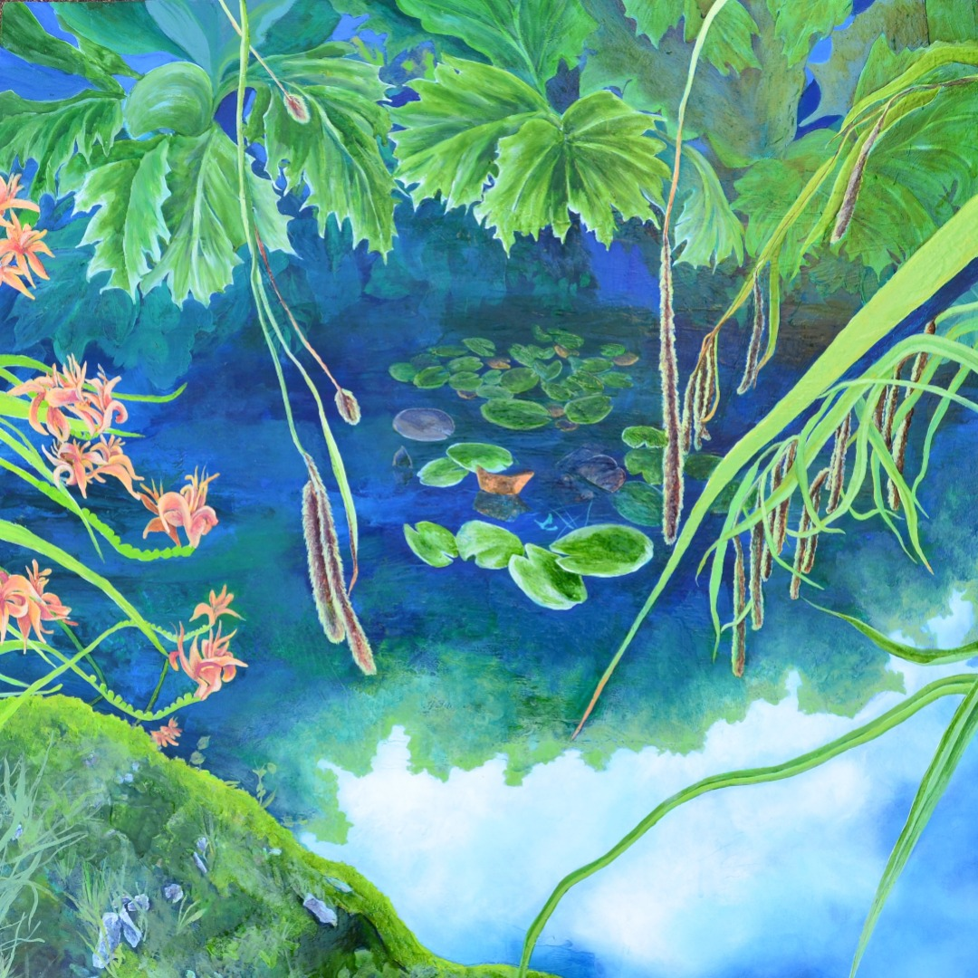
Committee 2023
(confirmed so far!)
Lynne Staples-Scott
Charley Sim
Val Thomson
Amy Shennan Pates
Louise Lemmon
Susie Hunt
Mahri Prince
Connie Robertson
Carol Hiles
Sara Harper
Lisa Petrie
Chantal Menneghin

Slide 32
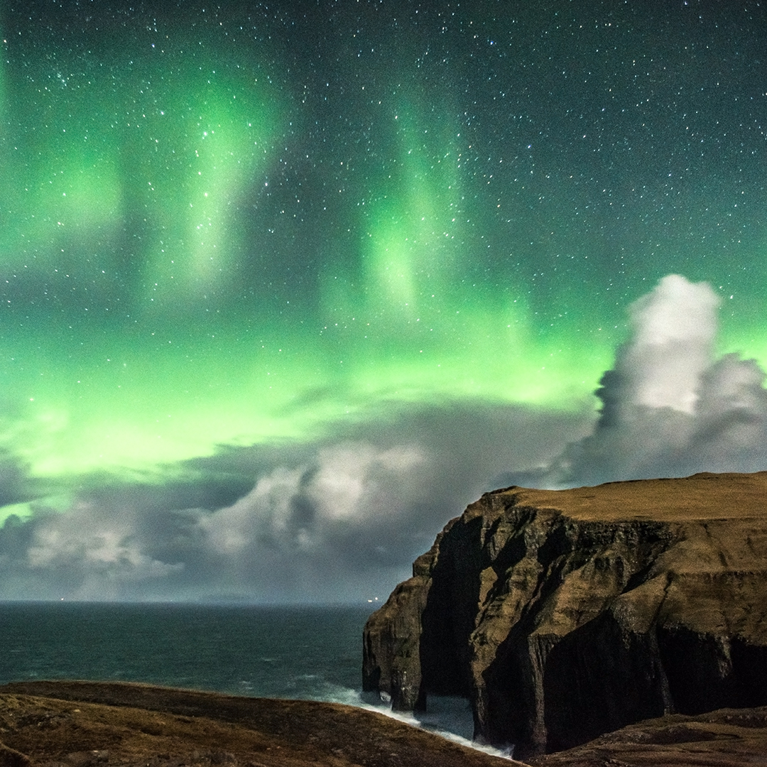
Looking Ahead
New website
New signs
Escalating book costs
Social Media
Mobile phone app
Funding options
Crowd funding
Lottery application
Increase in membership fee (£20/15% max)
Donations/sponsorships

Slide 33
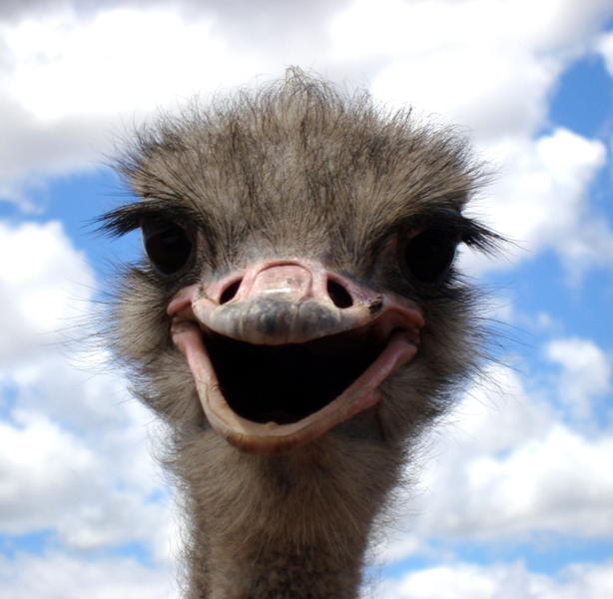
Any Questions?

